Slide 1
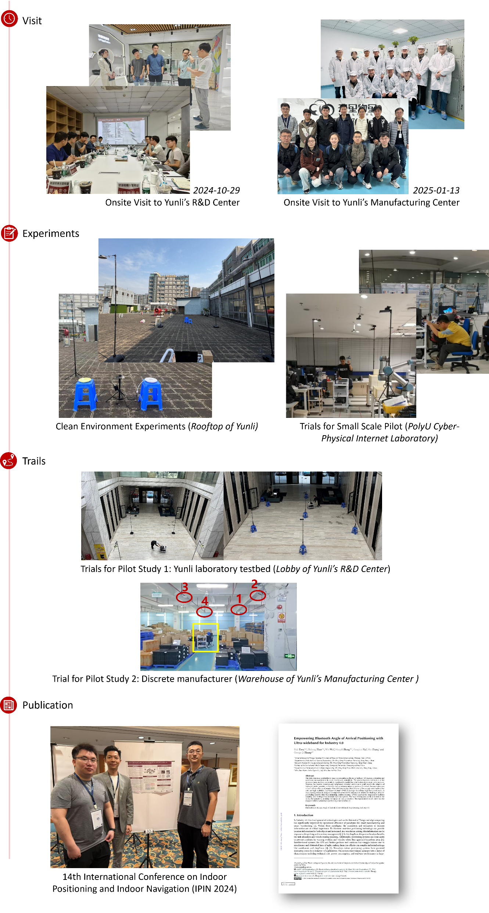
Trails for Small Scale Pilot (PolyU Smart Manufacturing Laboratory)

Slide 2
